Slide 1
Backpacking with Code: Software Portability for DHTC
Christina Koch (ckoch5@wisc.edu)
OSG User School 2022

Slide 2
Goals For This Session
Describe what it means to make software “portable”
Understand the basics of...
how software works
where software is installed
how software is accessed and run
...and the implications for Distributed High Throughput Computing (DHTC) and software portability.
Learn about and use software portability techniques

Slide 3
An Analogy
Running software on your own computer is like cooking in your own kitchen.
Photo by jschantz on flickr, CC-BY

Slide 4
On Your Computer
You know what you already have.
All the software you need is already installed.
You know where everything is (mostly).
You have full control.
You can add new programs when and where you want.

Slide 5
The Challenge
Running on a shared computer is like cooking in someone else’s kitchen.
Photo by F Deventhal on Wikimedia, CC-BY

Slide 6
On Someone Else’s Computer
What’s already there?
Is R installed? Or Python? What about the packages you need?
Do you know where anything is?
Are you allowed to change whatever you want?

Slide 7
The Solution
Think like a backpacker.
Take your software with you.
Install anywhere
Run anywhere
This is called making software portable.
Photo by Derrick Mercer on Flickr, CC-BY-SA

Slide 8
preliminary Concepts

Slide 9
Running Commands
When we submit a job, our primary “work” is expressed as a command (or multiple commands) that can be run on the command line*. For example:
$ python analysis.py input0.csv
$ blast -db pdbaa/pdbaa -query mouse.fa -out mouse.result
$ gmx pdb2gmx -f pro.gro -o mol.gro
*prerequisite for running HTC jobs: your work can be run from the command line

Slide 10
Software Is Files
Behind the scenes, any commands we run are actually using software files stored somewhere on the computer.
$ python analysis.py input0.csv
$ blast -db pdbaa/pdbaa -query mouse.fa -out mouse.result
$ gmx pdb2gmx -f pro.gro -o mol.gro

Slide 11
Software Is Files
How to see the software program “echo”:
$ echo Echo is a command
Echo is a command
$ which echo
/usr/bin/echo
$ ls -lh /usr/bin

Slide 12
Command Line and Location
To run a program on the command line, your computer needs to know where the program is located in your computer’s file system.
$ ls
$ python
$ ~/wrapper.sh
How does the command
line know what `ls` is?
Where is python installed?

Slide 13
Software Locations
The shell keeps a list of software file locations stored in a variable called the PATH. We can print it out using “echo”:
What if we want to run our *own* program – how do we tell the command line where it is?
$ echo $PATH

Slide 14
Two Location Options
Provide a path (relative or absolute)
[~/Code]$ mypy/bin/python --version
Python 2.7.7
Use “the” PATH
$ export PATH=/Users/alice/Code/mypy/bin:$PATH
$ echo $PATH
/Users/alice/Code/mypy/bin:/usr/local/bin:/usr/bin:/bin:/usr/sbin:/sbin
$ which python
/Users/alice/Code/mypy/bin/python

Slide 15
Location, Location, Location
Where can software be installed?
bin/
bin/
system locations
/
usr/
local
lib/
ada/
home/
local locations
al/

Slide 16
Location, Location, Location
Who can add to these locations?
bin/
bin/
administrator
/
usr/
local
lib/
ada/
home/
folder owner
al/

Slide 17
Location, Location, Location
On the OSPool, we need to assume that we are *not* administrators and our software needs to be installable and runnable from local folders
bin/
bin/
administrator
/
usr/
local
lib/
ada/
home/
folder owner
al/

Slide 18
Portability Summary
Run “anywhere” by:
bringing along the (Linux-compatible) software files you need…
to a location you can access/control…
telling the command line where that location is…
and using it to run your code.

Slide 19
Demo
GUI → Command line
Full installation → Bring along files
Using installation location
Demo files: https://github.com/ChristinaLK/osg-school-sw-demo

Slide 20
Portability Summary
Run “anywhere” by:
bringing along the (Linux-compatible) software files you need…
to a location you can access/control…
telling the command line where that location is…
and using it to run your code.
Using Downloaded or Compiled Software Files
Using Software Files in a Container

Slide 21
Bring Along Software Files

Slide 22
Ways to Prepare Software Files
Download pre-compiled software
Compile yourself
Single binary file
Installation contained in a single folder
We always need a “compiled” file of some kind.

Slide 23
What is Compilation?
Source Code
Binary
compiled + linked into
compiler
and OS
libraries
uses
run on
binary code by Kiran Shastry from the Noun Project
Source Code by Mohamed Mbarki from the Noun Project
Computer by rahmat from the Noun Project
books by Viral faisalovers from the Noun Project

Slide 24
What is Compilation?
Source Code
Binary
compiled + linked into
compiler
and OS
libraries
uses
run on
binary code by Kiran Shastry from the Noun Project
Source Code by Mohamed Mbarki from the Noun Project
Computer by rahmat from the Noun Project
books by Viral faisalovers from the Noun Project

Slide 25
Static Linking
Source Code
Static Binary
compiled + static link into
compiler
and OS
libraries
run anywhere
Book by Aleksandr Vector from the Noun Project

Slide 26
Compilation Process
Use a compiler (like gcc) directly
Can use options to control compilation process
More common:
./configure (or cmake)
make
make install
Installation options (like where to install) are usually set at the configure/cmake step

Slide 27
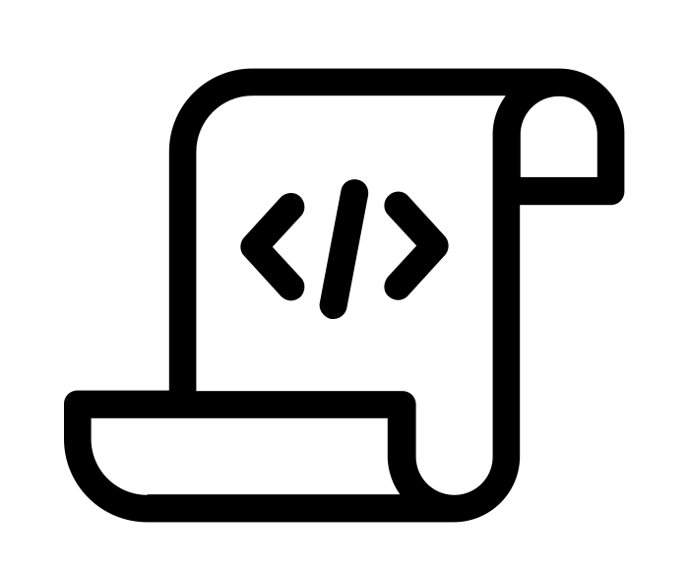
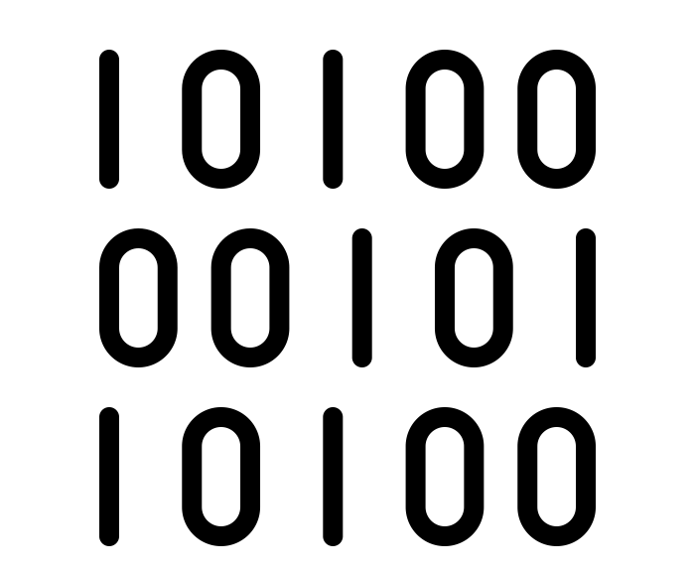
Interpreted Code
Instead of being compiled and then run…
…interpreted languages are translated into binary code “on the fly.”
script by Adrien Coquet from the Noun Project
translate by Adrien Coquet from the Noun Project
coding by Vectorstall from the Noun Project

Slide 28
Interpreted Code
And the interpreter is itself a binary file.
binary file
script by Adrien Coquet from the Noun Project
translate by Adrien Coquet from the Noun Project
coding by Vectorstall from the Noun Project

Slide 29
What Kind of Code?
Programs written in C, C++ and Fortran are typically compiled.
For interpreted (scripting) languages like perl, Python, R, or Julia:
Don’t compile the scripts, but *do* use a compiled copy of the underlying language interpreter.

Slide 30
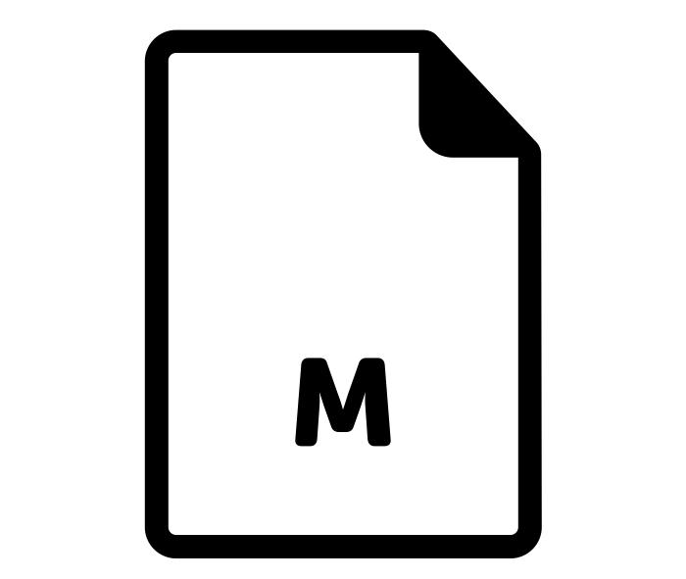
Matlab
Matlab is a scripting language…but can also be compiled.
compile .m files using Matlab compiler (mcc)
[Requires license]
compiled file and Matlab Runtime work together to run program.
[no license needed]
M File by Viktor Vorobyev from the Noun Project
Gears by Trevor Dsouza from the Noun Project

Slide 31
Run "Brought-Along" Software Files

Slide 32
Ways to Run Software
Executable
Wrapper Script
Software must be a single compiled binary file or single script.
Software can be in any compiled format.
executable = run_program.sh
transfer_input_files =
program.tar.gz
queue 1
executable = program.exe
queue 1
#!/bin/bash
# run_program.sh
tar –xzf program.tar.gz
program/bin/run in.dat
program.exe
Notes:
do something with colors or arrows

Slide 33
Single Binary Workflow
Execute server
Option 1
Submit server
compile
(static) binary
Option 2
download

Slide 34
Wrapper Script Workflow
Execute server
Submit server
set up run
wrapper script
set up run
source code, compiled code or single binary
set up run
script by ✦ Shmidt Sergey ✦ from the Noun Project

Slide 35
Bring Along Containers
Notes:
work on transition into containers

Slide 36
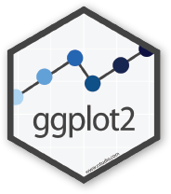
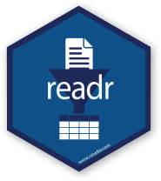
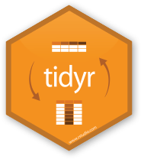
Containers
Containers are a tool for capturing an entire job “environment” (software, libraries, operating system) into an “image” that can be used again.
Credit: polaroid photos by Nick Bluth from the Noun Project

Slide 37
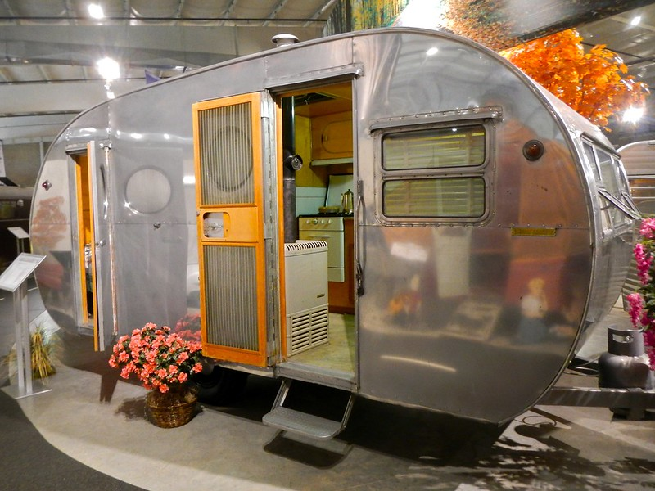
Returning to Our Analogy…
Using a container is kind of like bringing along a whole kitchen…
Photo by PunkToad on Flickr, CC-BY

Slide 38
Why Containers?
Why use containers instead of the methods we just discussed?
Notes:
multiply this slide?

Slide 39
Why Containers?
Complex installations: software that has a lot of dependencies or components.
Photo on pikrepo
Notes:
multiply this slide?

Slide 40
Why Containers?
Software that can’t be moved: do files or libraries have to be at a specific path?
Photo by R. Miller on Flickr, CC-BY
Notes:
multiply this slide?

Slide 41
Why Containers?
Sharing with others: one container can be used by a whole group that’s doing the same thing.
Photo by Ella Olsson on Flickr, CC-BY
Notes:
multiply this slide?

Slide 42
Why Containers?
Running on different systems: The same container can run on Linux, Mac and Windows
Photo by Ilona Frey on Unsplash
Notes:
multiply this slide?

Slide 43
Why Containers?
Reproducibility: save a copy of your environment.
Photo by Marco Verch on Flickr, CC-BY
Notes:
multiply this slide?

Slide 44
Getting Containers
To use a container as your software portability tool, need to either:
Find a pre-existing container with what you need.
Build your own container.*
* not covered today

Slide 45
Container Types
Two common container systems:
Docker Singularity
https://www.docker.com/ https://sylabs.io/
Notes:
discuss a bit more about these – and how they’re used in jobs.
Distinguish between container/image + engine?

Slide 46
Container Types
Container system =
Container image format
Container "engine" for running
Image Format
Always Linux-based
Docker images can be converted to Singularity images
"Engine" capabilities
Singularity "engine" can run both Docker + Singularity images
Docker "engine" installs on Linux, Mac, Windows, meaning Docker containers can be run on any OS
Notes:
discuss a bit more about these – and how they’re used in jobs.
Distinguish between container/image + engine?

Slide 47
Run Containers

Slide 48
Submit File Requirements
Docker (from CHTC Access Point)
Singularity (from OSPool Access Point)
universe = docker
docker_image = centos/python-34-centos7:latest
+SingularityImage = "/cvmfs/singularity.opensciencegrid.org/centos/python-34-centos7:latest"
Notes:
Update singularity image!! (check exercise also)

Slide 49
Container Workflow
Execute server(s)
Submit server
script
+ name of container image
container
image
Registry (e.g. DockerHub)

Slide 50
Wrapping up

Slide 51
Conclusion
To use any software in a DHTC system:
Create/find software files:
download pre-compiled code, compile your own, create/find a container
Account for all dependencies, files, and requirements in the submit file.
If needed, write a wrapper script to set up the environment when the job runs.

Slide 52
Acknowledgements
This work is supported by NSF under Cooperative Agreement OAC-2030508 as part of the PATh Project. Any opinions, findings, and conclusions or recommendations expressed in this material are those of the author(s) and do not necessarily reflect the views of the NSF.

Slide 53
Old slides

Slide 54
How Software Works*
*Not to scale
Program
(software, code, executable, binary)

Slide 55
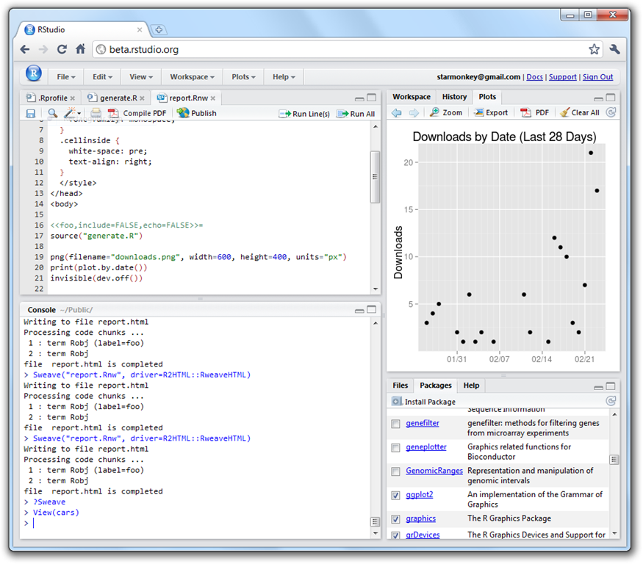
How Software Works*
*Not to scale
Program
(software, code, executable, binary)
Running Program
(process, instance)
launches to

Slide 56
How Software Works*
*Not to scale
Program
(software, code, executable, binary)
Running Program
(process, instance)
launches to
depends on
runs own tasks

Slide 57
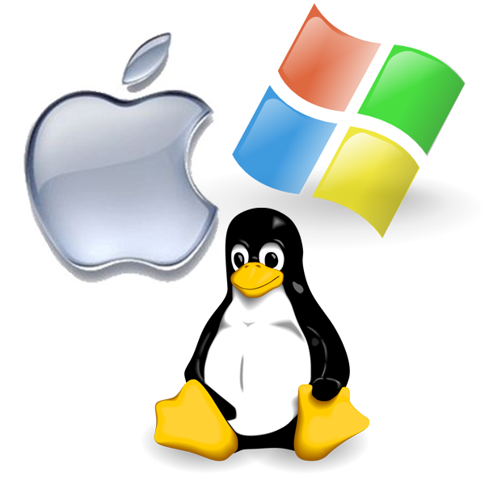
How Software Works*
*Not to scale
Program
(software, code, executable, binary)
Running Program
(process, instance)
Operating System
makes requests
launches to
monitors running programs
depends on
runs own tasks

Slide 58
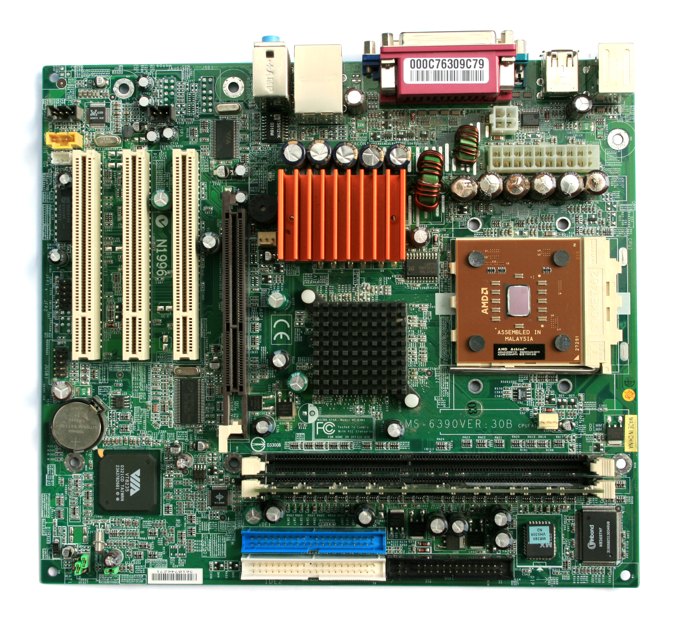
How Software Works*
*Not to scale
Program
(software, code, executable, binary)
Running Program
(process, instance)
Operating System
Hardware
(processors, memory, disk)
makes requests
launches to
monitors running programs
translates program’s request
depends on
runs own tasks

